Slide 1
Software Verification Validation and Testing
Presented by : Neha Tripathi

Slide 2
Verification activities
Verification and Validation activities
Verification and its activities

Slide 3
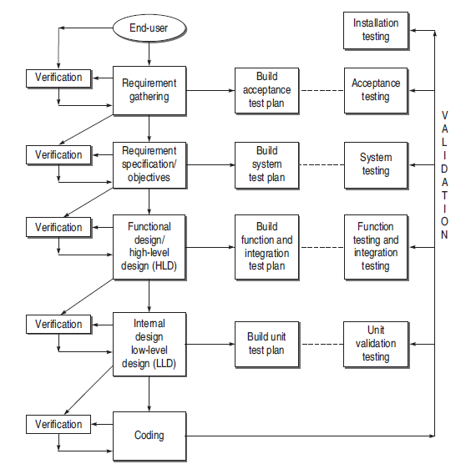
Verification and Validation activities

Slide 4
Verification
Verification is needed for the following:
If verification is not performed at early stages, there are always a chance of mismatch between the required product and the delivered product.
Verification exposes more errors.
Early verification decreases the cost of fixing bugs.
Early verification enhances the quality of software.

Slide 5
Verification activities
All the verification activities are performed in connection with the different phases of SDLC. The following verification activities have been identified:
Verification of Requirements and Objectives
Verification of High-Level Design
Verification of Low-Level Design
Verification of Coding (Unit Verification)

Slide 6
Verification of requirements
Verification of gathered requirements
All the requirements gathered from the user’s viewpoint are verified. For this purpose, an acceptance criterion is prepared. An acceptance criterion defines the goals and requirements of the proposed system and acceptance limits for each of the goals and requirements. The tester performs the following two activities:
The tester reviews the acceptance criteria in terms of its completeness, clarity, and testability. Moreover, the tester understands the proposed system well in advance so that necessary resources can be planned for the project.
The tester prepares the Acceptance Test Plan which is referred at the time of Acceptance Testing.

Slide 7
Verification of objectives
After gathering requirements, specific objectives are prepared considering every specification. These objectives are prepared in a document called software requirement specification (SRS). In this activity also, two parallel activities are performed by the tester:
The tester verifies all the objectives mentioned in SRS. The purpose of this verification is to ensure that the user’s needs are properly understood before proceeding with the project.
The tester also prepares the System Test Plan which is based on SRS. This plan will be referenced at the time of System Testing . In verifying the requirements and objectives, the tester must consider both functional and non-functional requirements.

Slide 8
Every requirement in SRS should be verified for:
Correctness
Unambiguous
Consistent
Completeness
Updation
Traceability

Slide 9
Verification of High-Level Design
The architecture and design is documented in a document called the software design document (SDD).Here the tester is responsible for two parallel activities :
The tester verifies the high-level design. Since the system has been decomposed in a number of sub-systems or components, the tester should verify the functionality of these components.
The tester also prepares a Function Test Plan which is based on the SRS. This plan will be referenced at the time of Function Testing .The tester also prepares an Integration Test Plan which will be referred at the time of integration testing.
Design is divided in three parts that needs to be verified:
Data Design
Architectural Design
Interface Design

Slide 10
Verification of Data Design
The points considered for verification of data design are as follows:
Check whether the sizes of data structure have been estimated appropriately.
Check the provisions of overflow in a data structure.
Check the consistency of data formats with the requirements.
Check whether data usage is consistent with its declaration.
Check the relationships among data objects in data dictionary.
Check the consistency of databases and data warehouses with the requirements specified in SRS.

Slide 11
Verification of Architectural Design
The points considered for the verification of architectural design are:
Check that every functional requirement in the SRS has been take care of in this design.
Check whether all exceptions handling conditions have been taken care of.
Verify the process of transform mapping and transaction mapping, used for the transition from requirement model to architectural design.
Since architectural design deals with the classification of a system into sub-systems or modules, check the functionality of each module according to the requirements specified.
Check the inter-dependence and interface between the modules.
In the modular approach of architectural design, there are two issues with modularity— Module Coupling and Module Cohesion. A good design will have low coupling and high cohesion. Testers should verify these factors, otherwise they will affect the reliability and maintainability of the system which are non-functional requirements of the system.

Slide 12
Verification of User-Interface Design
The points to be considered for the verification of user-interface design are:
Check all the interfaces between modules according to the architecture design.
Check all the interfaces between software and other non-human producer and consumer of information.
Check all the interfaces between human and computer.
Check all the above interfaces for their consistency.
Check the response time for all the interfaces are within required ranges. It is very essential for the projects related to real-time systems where response time is very crucial.

Slide 13
Verification of Low-Level Design
Testers performs the following parallel activities in this phase:
The tester verifies the LLD. The details and logic of each module is verified such that the high-level and low-level abstractions are consistent.
The tester also prepares the Unit Test Plan which will be referred at the time of Unit Testing.
This is the last pre-coding phase where internal details of each design entity are described. For verification, the SRS and SDD of individual modules are referred to. Some points to be considered are listed below:
Verify the SRS of each module.
Verify the SDD of each module.
In LLD, data structures, interfaces, and algorithms are represented by design notations; verify the consistency of every item with their design notations.

Slide 14
Verification of Coding (Unit Verification)
Code must be verified for:
Check that every design specification in HLD and LLD has been coded using traceability matrix.
Examine the code against a language specification checklist.
Code verification can be done most efficiently by the developer, as he has prepared the code. He can verify every statement, control structure, loop, and logic such that every possible method of execution is tested. In this way, he verifies the whole module which he has developed. Some points against which the code can be verified are:
(a) Misunderstood or incorrect arithmetic precedence
(b) Mixed mode operations
(c) Incorrect initialization
(d) Precision inaccuracy
(e) Incorrect symbolic representation of an expression
(f) Different data types
(g) Improper or non-existent loop termination
(h) Failure to exit

Slide 15
Two kinds of techniques are used to verify the coding:
(a) static testing, and
(b) dynamic testing.
Static testing techniques :this technique does not involve actual execution. It considers only static analysis of the code or some form of conceptual execution of the code.
Dynamic testing techniques It is complementary to the static testing technique. It executes the code on some test data. The developer is the key person in this process who can verify the code of his module by using the dynamic testing technique.

Slide 16
Unit verification
Unit verification is performed for:
Interfaces are verified to ensure that information properly flows in and out of the program unit under test.
The local data structure is verified to maintain data integrity.
Boundary conditions are checked to verify that the module is working fine on boundaries also.
All independent paths through the control structure are exercised to ensure that all statements in a module have been executed at least once.
All error handling paths are tested.
Unit verification is largely white-box oriented.

Slide 17
Thank You!

